Slide 1
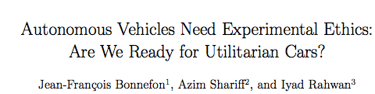
Chad-michael Muirhead
Date: September 25,2017
https://pdfs.semanticscholar.org/13d4/56d4c53d7b03b90ba59845a8f61b23b9f6e8.pdf

Slide 2
BACKGROUND
Objective
To determine if Autonomous vehicles can be entrusted by society to make acceptable moral decisions.
Autonomous Vehicles are vehicles which guide themselves based on user input by using programmed instructions, sensors and cameras.
Moral algorithms are instructions programmed into the vehicle which allows it to make moral decisions
Autonomous vehicles reduce pollution, increase traffic efficiency and reduces approximately 90% of traffic accidents
Self-sacrifice is the act of harming oneself in an effort to save a large group of people
Notes:
Should manufacturer, insurance be responsible?

Slide 3
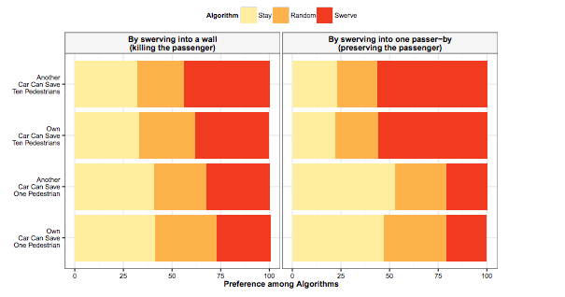
RESULTS
3 Studies Controlled for :
Sex, Age and Religiosity
Satisfied with AVs programmed to reduce accident death toll
Same gender models used to depict another car separate from owner car
Preference in swerving into passer-by when could save 10 but not 1
Notes:
Study 1- 241 men& 161 women age:30 SWERVE or STAY
Study 2 - 144 men & 166 women age:30 ALWAYS STAY,SWERVE or RANDOM
Study 3 – 97 men & 104 women age:30 like study 1

Slide 4
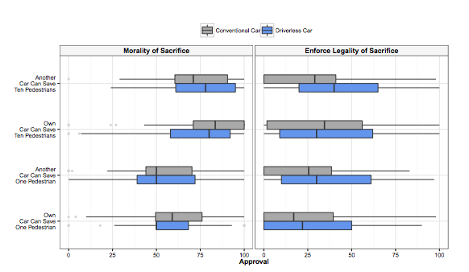
RESULTS
Welcomed self-sacrifice for AVs by law if could save more lives
Preferred self-sacrifice decision made by the AV rather than human
Manufacturers would focus on owner protection as priority
Participants(Study 2) supported others buying vehicles with self-sacrifice programming, they were less wiling to buy them themselves
Notes:
Study 2 - 144 men & 166 women age:30 ALWAYS STAY,SWERVE or RANDOM
Morality – Human
Other - AV

Slide 5
CONCLUSION
Participants appear to be prepared for Autonomous Vehicles to perform utilitarian acts if there was unavoidable harm
Self-sacrifice enforcement by law for AVs was accepted more than for conventional vehicle owners
People encourage self-sacrifice for others in AVs but it is not the case if one’s own life is at risk
Blame assignment in the cases of unavoidable accidents is difficult to determine
Option to chose accident prevention algorithms such as: Random , Self-Sacrifice or Owner Protection
How should AV execute decision if children or other passengers are in the vehicle
Notes:
NM: blame assign,children, algo( should buyer be blamed for his/her choice)
Even without law AV should be programmed for self-sacrifice

